Slide 1


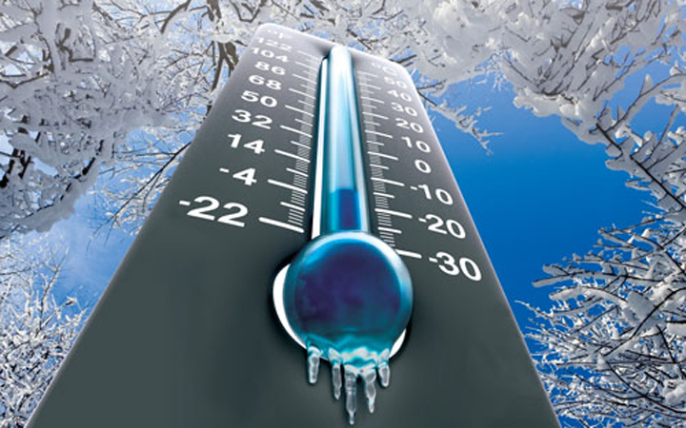



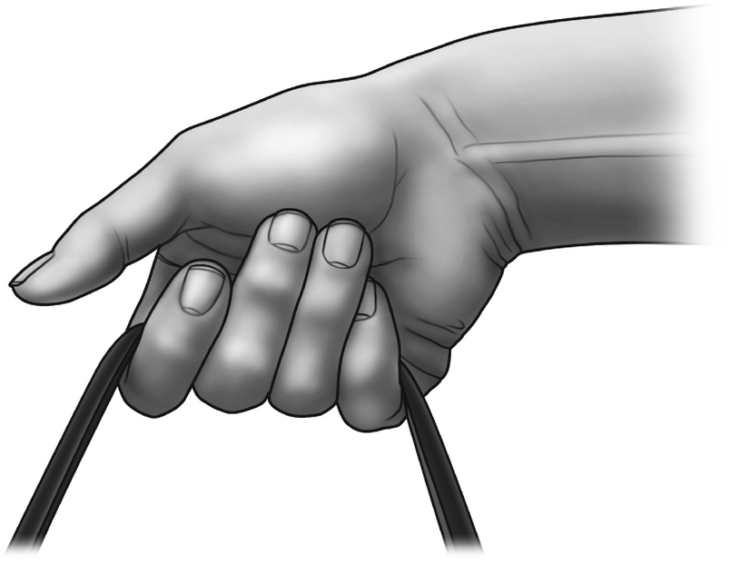

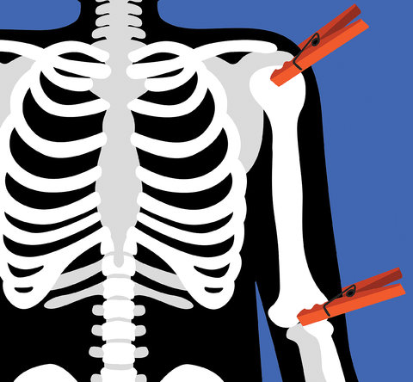
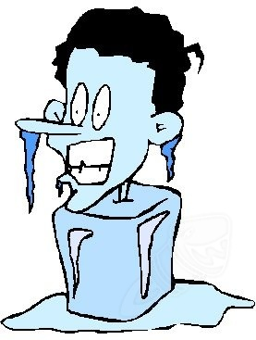
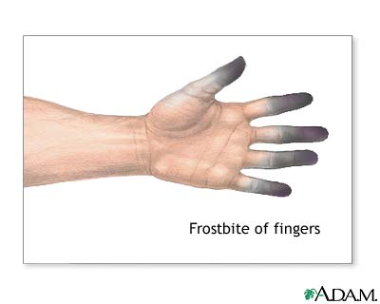
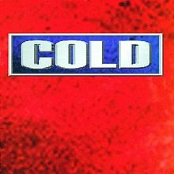

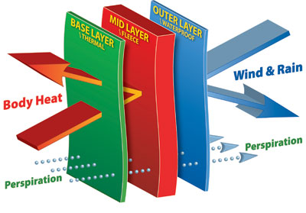

IMPAIRED MENTAL
ALERTNESS
It is hard to focus on the task when cold
REDUCED SENSITIVITY
& DEXTERITY
OF FINGERS
The toes, fingers, ears, nose are at the greatest risk
because they lack major muscles to generate heat
leading to loss of the ability to use fingers/hands
( dexterity )
REDUCED
MUSCUCLAR STRENGHTH
CAN LEAD TO INJURIES AND ILLNESSES
COLD AIR
TEMPERATURE
HIGH VELOCITY AIR MOVEMENT DAMPNESS OF AIR
STIFFENED JOINT AND
TISSUE DAMAGE
COLD STRESS
HYPOTHERMIA
The inability to maintain central core temperature is the most severe cold injury. The excessive loss of body heat can be fatal
FROST BITE
AVOID DIRECT CONTACT WITH COLD WATER OR SURFACES
KNOW THE STAGES OF HYPOTERMIA AND THE FIRST AID-Inform the medic
KNOW THE SIGNS AND SYTOMS OF FROST BITE AND FRIST AID TREATMENT
Select proper clothing for cold, wet and windy conditions.
Layer clothing to adjust to changing environmental temperatures-avoid exposed skin
Take frequent short breaks in warm, dry shelters to allow the body to warm up. Work in pairs- use the buddy system to recognize cold stress
Drink warm, sweet beverages. Avoid drinks with caffeine or alcohol.
Check and monitor the weather-Temperature and Wind
Adjust the pace/rate of work- not to low getting cold and not to high creating wet clothes due to heavy sweating
Prevention
1
122
3
4
Do you now what is on the other side of that door before you go out on deck to work on the towing
winch?
5
6
7
8
Crew need to maintain a core body temperature of + 37 C for normal body functioning as well as to provide energy for activity

