Slide 1


Case study two
MARI-4107
Communications & Conflict Management
The Case of Temperament Talent by:
Laurence R. Rothstein

Slide 2
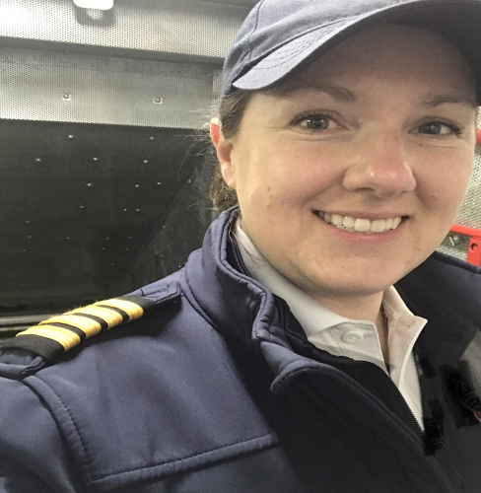


The Group
MARI-4107
Communications & Conflict Management
Laura
Timothy
Susan

Slide 3
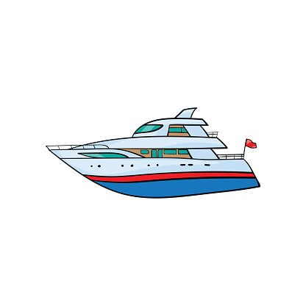
Outline
MARI-4107
Communications & Conflict Management
Tidewater Corporation
1.Background:
2.Problem Statement:
3. Analysis and Alternatives:
4.Recommendations:
Manufacturer of luxury power boats
Notes:
the manufacturer of luxury power boats

Slide 4

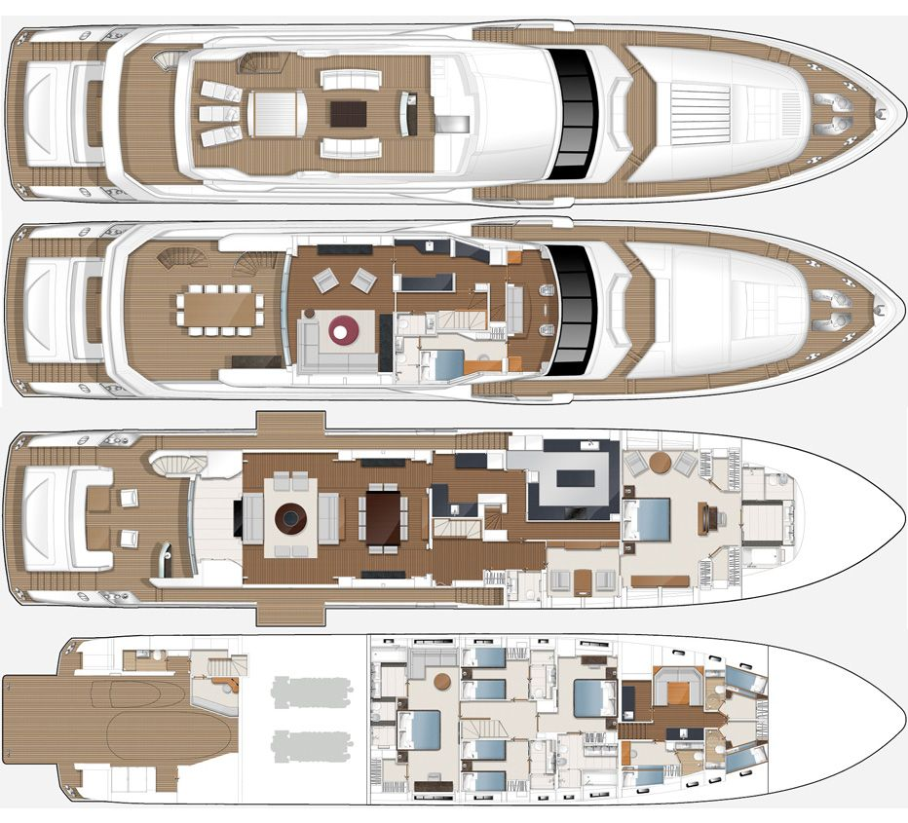
MARI-4107
Communications & Conflict Management
Background-con’t
Bob Salinger, the CEO of Tidewater Corporation
Ken Vaughn is the head of the Design Department of Tidewater

Slide 5
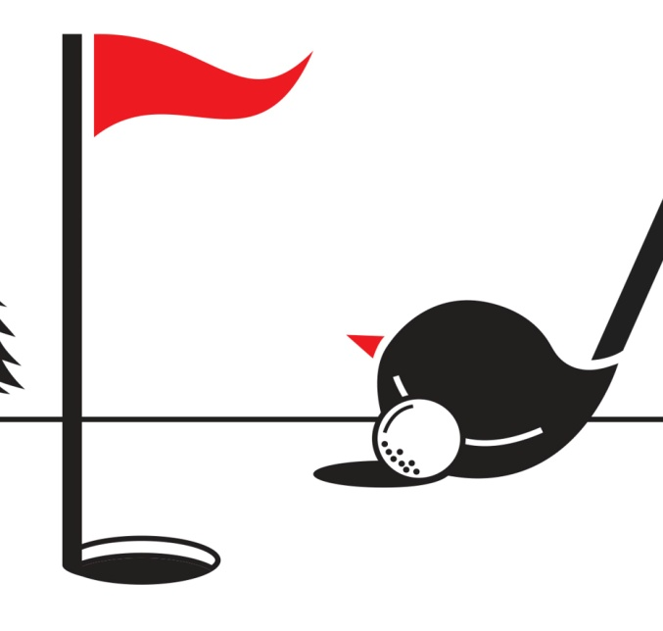
Background-con’t
MARI-4107
Communications & Conflict Management
Ken is very talented at his job of which Bob values and appreciates.
Over time, Ken gained a reputation as being the best and brightest individuals in his field among his peers.
Bob and Ken developed a strong friendship and professional working relationship, that was founded on mutual respect and weekend rounds of golf.
Notes:
f

Slide 6
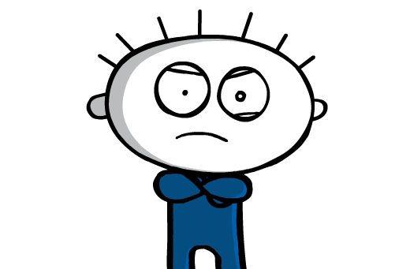
Perceptions of Ken have changed as he is displaying toxic behaviors at work:

Slide 7
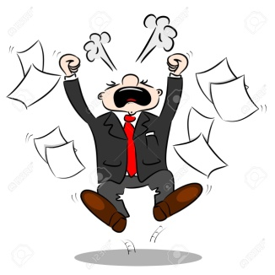
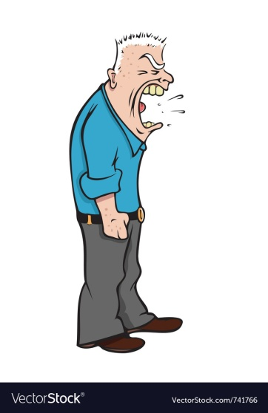

Background-con’t
MARI-4107
Communications & Conflict Management
Temper
Mood swings
Uncooperative
Quiet Withdrawn
Unengaged
Characteristics of bullying
Falling behind on deadlines
Progressive violent/aggressive
behavior
Difficult to reason with
Withholding information

Slide 8

Background-con’t
MARI-4107
Communications & Conflict Management
Notes:
For example, at a company picnic he became intoxicated and proceeded to insult members of the sales staff.

Slide 9


Background-con’t
MARI-4107
Communications & Conflict Management
The mood swings were also witnessed by Ken’s wife at home
Recently he suddenly disappeared mid work week for a couple of days, telling no one including his wife.
Notes:
She reached out to Bob to seek a possible explanation to her husband's changing behavior.

Slide 10


Background-con’t
MARI-4107
Communications & Conflict Management
It was at this point where Bob knew he had to take action and initially intervened.
Harold Bass, head of the Human Resources Department, stepped in to assist in the situation, suggesting the company's EAP.
Notes:
Ken did not welcome the suggestions to seek therapeutic as he viewed it as an attack on his confidence and dignity.

Slide 11


Background-con’t
MARI-4107
Communications & Conflict Management
Ken did see a therapist, after being pressured by Bob to pursue it.
During therapy -it was revealed that Ken was experiencing difficulty dealing with the stress that was involved in his job
He was also showing signs of a mid-life crisis
Notes:
-by wearing his motorcycle attire and riding his Harley Davison

Slide 12

Background-con’t
MARI-4107
Communications & Conflict Management
RECONSTRUCTION IS HAPPENING-Led by Morris Redstone
- Move Tidewater into the 21st century
-Competitive with rival companies
-Maintain market value
He was also showing signs of a mid-life crisis by wearing his motorcycle attire and riding his Harley Davison
Notes:
Therefore company reorganization, personnel changes, and abandoning traditional construction methods are occurring.

Slide 13

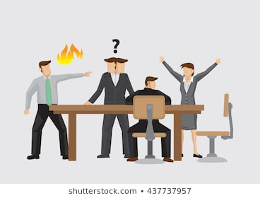
Background-con’t
MARI-4107
Communications & Conflict Management
Ken felt that reconstructing was going to weaken his creative and innovative contributions and talents, of which he was so fondly admired for.
He did not have good relations with Redstone because of this and this tension was becoming progressively worst as weekly restructuring meetings took place.

Slide 14
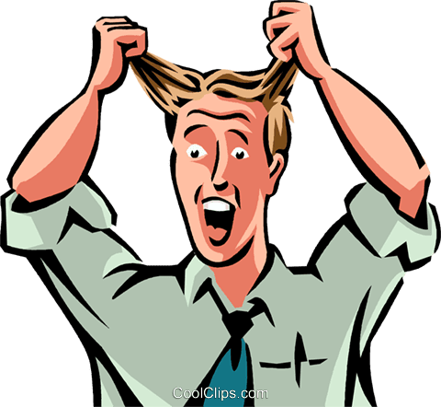


MARI-4107
Communications & Conflict Management
Background-con’t
In fact, during the previous weekly restructuring meeting between Ken and Morris
Ken reacted in a very destructive manner by throwing a chair at the computer, and pushing items off a bookshelf. This has been the worst demonstration and most concerning of Ken's spiraling behavior

Slide 15
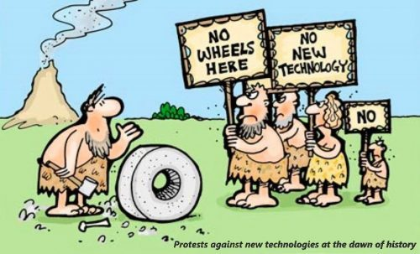
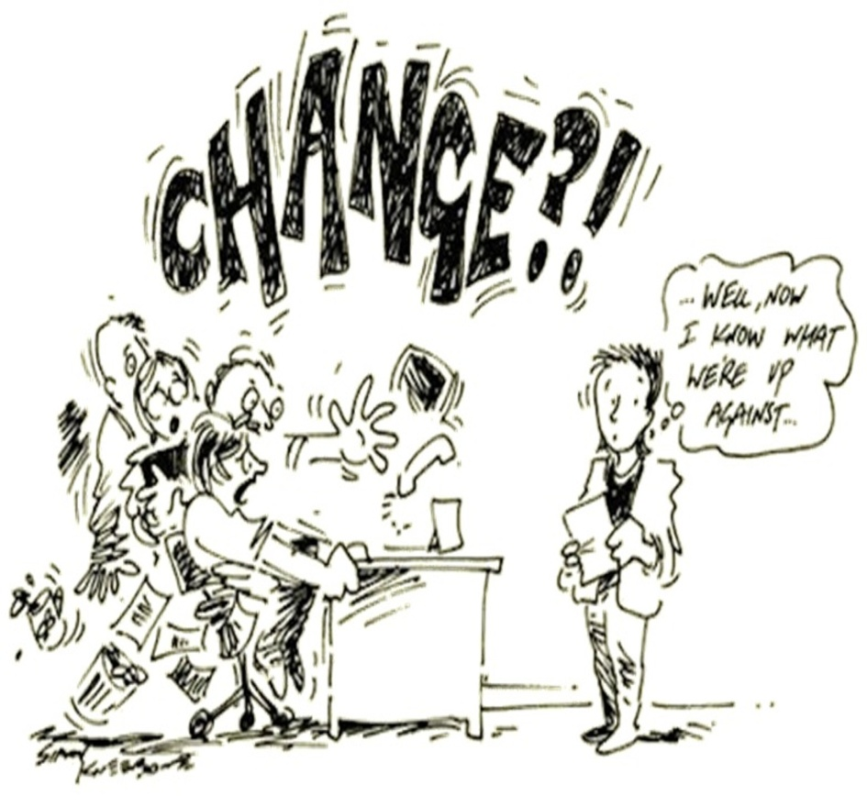
Background-con’t
MARI-4107
Communications & Conflict Management
The company is undergoing reorganization and Ken Vaughn is resisting this change as his behaviors have clearly confirmed this.

Slide 16
Outline
MARI-4107
Communications & Conflict Management
1.Background:
2.Problem Statement:
3. Analysis and Alternatives:
4.Recommendations:

Slide 17


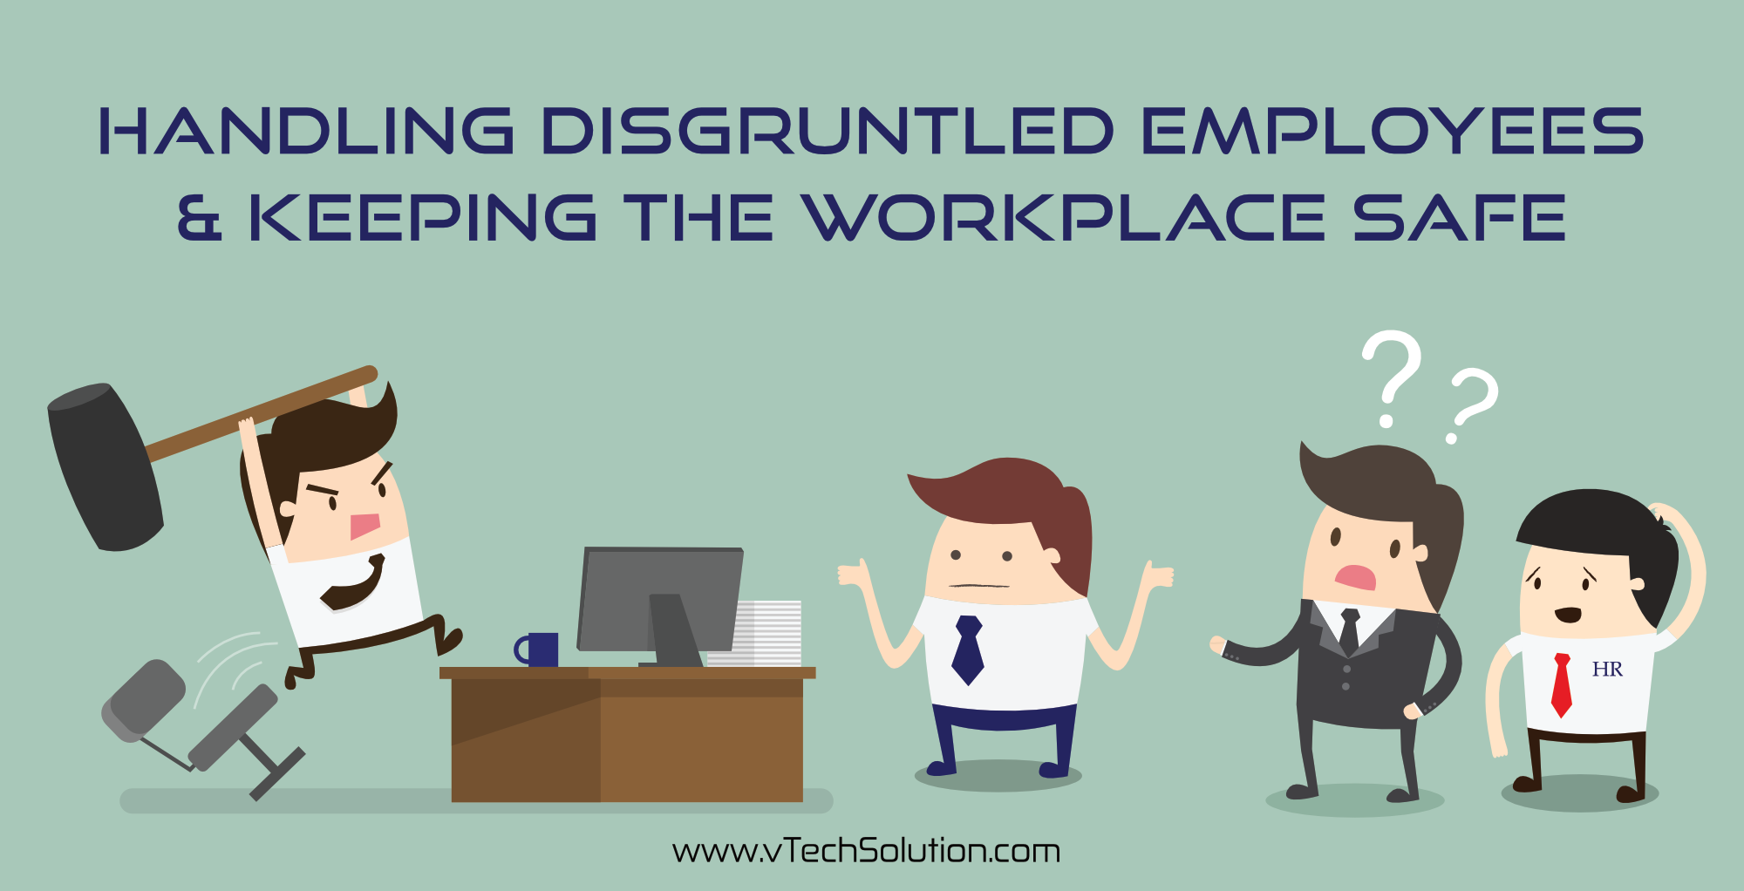
Problem Statement
The company has to decide how to intervene with this destructive behavior as it is slowing the reorganization process and creating a very stressful work environment which is clearly getting worse.
Bob has a very big decision to make determining whether Ken is too valuable to let go, or too volatile to keep within the best interests of the company restructuring plans moving forward.
.
Notes:
Morris has exhausted all avenues to deal with the situation and Harold's therapeutic suggestions appear not to be helping.
This leaves Bob to make some impact and historically he has been the only person who can influence Ken.
It is very clear after the previous meeting between Ken and Morris, the situation has reached the point where conflict management is deemed necessary.
Furthermore, as CEO of the company, he may be the only option and hope to deal with this escalated conflict.

Slide 18
Outline
MARI-4107
Communications & Conflict Management
1.Background:
2.Problem Statement:
3. Analysis and Alternatives:
4.Recommendations:

Slide 19
MARI-4107
Communications & Conflict Management
Alternative 1: Supportive Confrontation-focus on change in the environment
Alternative 2: Integrative Negotiation-BATNA
Alternative 3: Ending the Relationship

Slide 20
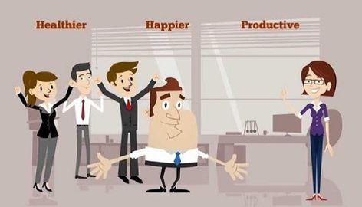
MARI-4107
Communications & Conflict Management
Alternative 1:
Supportive Confrontation-focus on change in the environment

Slide 21

Alternative 1: Supportive Confrontation
If Ken's behavior is left unresolved, the conflict will escalate even more than it already has. But there still is an opportunity to attempt conflict resolution through supportive confrontation.

Slide 22
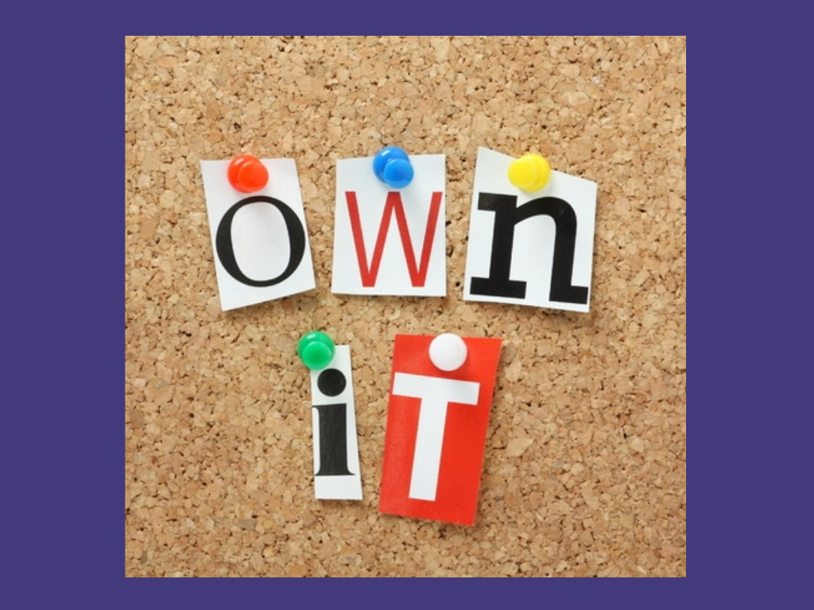
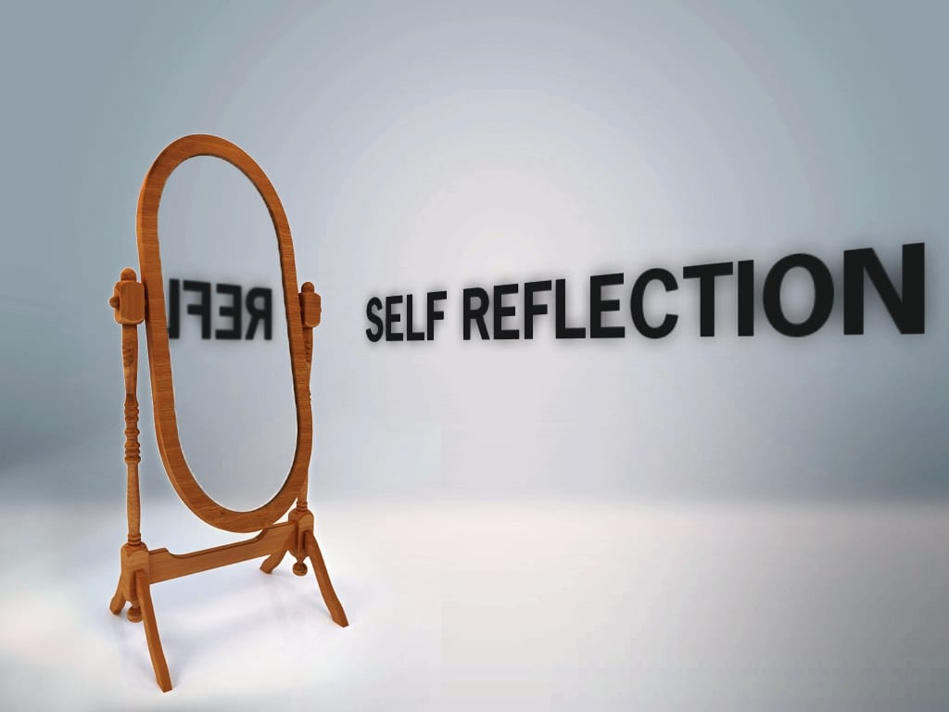


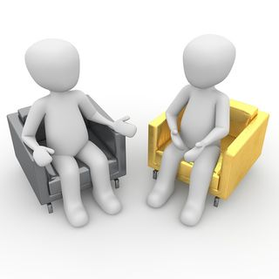

Alternative 1: Supportive Confrontation
Identify problem ownership using your window on behavior
Research and reflect
Select an alternative to follow (using the three alternatives rule)
Rehearse
Meet to resolve the conflict
Follow through and follow up
6 steps

Slide 23
Alternative 1: Supportive Confrontation
There is no doubt that Bob has ownership of the situation/problem and needs to take some time to self -reflect.

Slide 24

Alternative 1: Supportive Confrontation
At this point the work environment needs an overhaul since it has been so toxic recently. This is situation where efficiency is needed not quickness. The reality is, this will not happen overnight and Bob may need to seek out resources to help create this type of environment.
Once he does this he will be able to reason more critically. As soon as he develops this mindset Bob can move to the next step which is the three alternative rule, which are:
Change your attitude
Change your environment
Confront the person about his or her behavior.

Slide 25

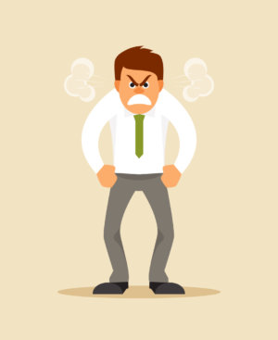
Alternative 1: Supportive Confrontation
Because emotions are very prominent in the case, Bob will need to rehearse for what he may face when he confronts Ken.
He needs to have a plan to deal anger and other undesired emotions. Doing this will disable the power Ken has over Bob giving supportive confrontation a chance of success.

Slide 26

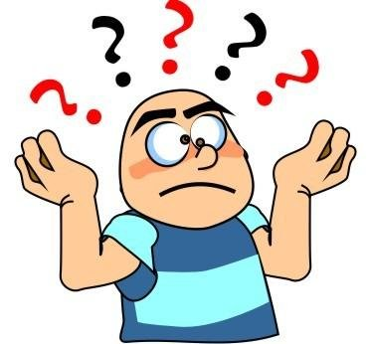
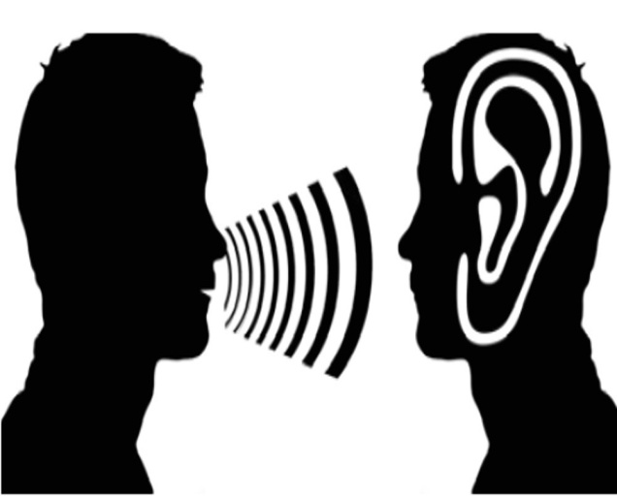
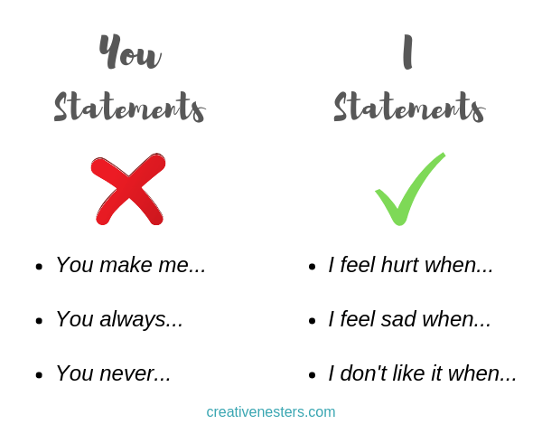
Alternative 1: Supportive Confrontation
Now Bob is ready at his first attempt to confront Ken.
First Ken needs to made aware of the impact his destructive behavior on the company's environment and preventing the reconstruction process from progressing.
Bob will need to actively listen to Ken
Use "I" statements- fewer "you" statements

Slide 27

Alternative 1: Supportive Confrontation
This may take several attempts and will take time. If it works he will need to follow through to determine if solutions are working both short term and long term.
Notes:
Ken may need consistent encouragement if he changes his ways and allows the reconstruction to occur.

Slide 28
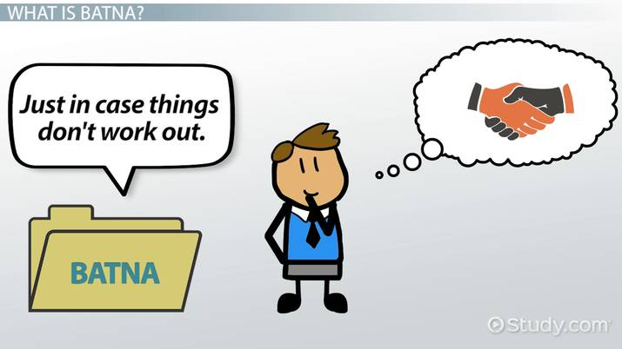
MARI-4107
Communications & Conflict Management
Alternative 2: Integrative Negotiation-BATNA

Slide 29

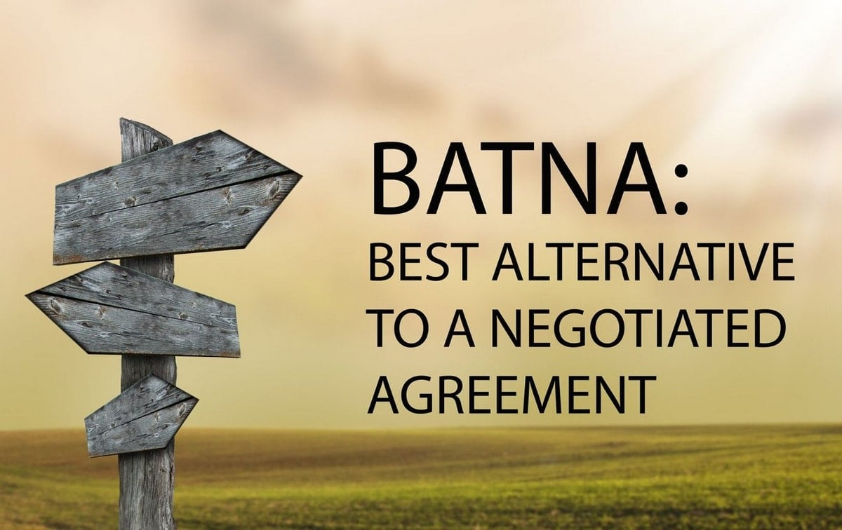
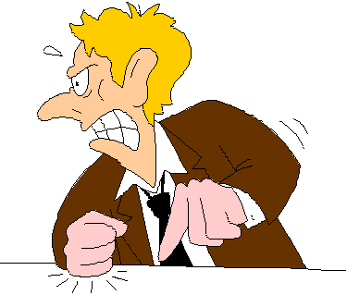
Alternative 2: Integrative Negotiation-BATNA
Explore mutual interests, determining compatibility, between the parties involved. The end goal would be to establish mutual gain(s), coming to an agreement that satisfies everyone,
Integrative negotiation using the BATNA ( Best alternative to negotiated agreement ).
Integrative negotiation doesn't always warrant a workable agreement but it will prevent and help maneuver away from a dire agreement, especially if the BATNA is used-which will give them power.
Tidewater need to determine what they hope to accomplish and achieve in an agreement with Ken, while knowing what proposed agreement they are willing to walk away from.
Because emotion is a central aspect of the integrative negotiation, as well as Ken's emotional outburst, it is important that Bob acknowledges and prepares to handle emotion, such as anger, that may arise

Slide 30
Alternative 2: Integrative Negotiation-BATNA
In order for integrative negotiation to be successful legitimacy, clear communication, and complete commitment to preserve relationships is required.
Legitimacy
Clear Communication
Commitment to preserve relationships

Slide 31
Alternative 2: Integrative Negotiation-BATNA
Proposals need to be in place when developing the BATNA prior to entering the negotiation which includes:
1
What the company aspires and will satisfy their interest as well as pinpointing what Ken's aspirations and interest will be.
2
What agreement will Tidewater be content with that will satisfy their interest.
3
What agreement is Tidewater willing to live with, which will sit just above the absolute minimum they are willing to accept before walking away.

Slide 32

MARI-4107
Communications & Conflict Management
Alternative 3: Ending the Relationship

Slide 33
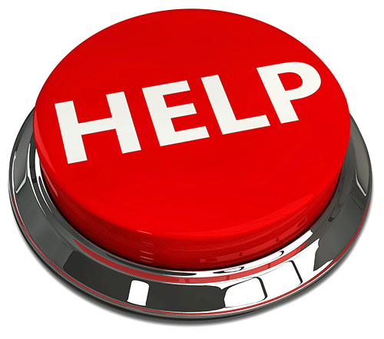

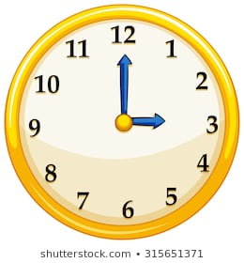

Alternative 3: Ending the Relationship
Ken’s behavior can no longer be tolerated - despite opportunities and chances given to make changes in his behavior.
Wasting time, effort and resources which can be directed towards the reconstruction process instead.
In reality, as stated, Bob has a close relationship with Ken, yet Bob’s main focus- steer the ship of the company, in a direction of prosperity, not to protect Ken’s fragile ego.
The company is at a crossroads, and Bob needs to show everyone who works for the company, that the restructuring and growth is paramount
The plan to move forward doesn't include Ken's resistance to teamwork, ineffective communication , complete lack of empathy in an effort to understand the rationale for reconstruction.
RESTRUCTURING

Slide 34
Alternative 3: Ending the Relationship
The value placed on Ken’s talents with the company are being over ridden by his unwillingness to co-operate during the reconstruction which is making it easier to consider to replacing him.
Establishing a Meeting location-safe
and private
Propose an Attractive severance package
Paperwork
-including a Confidentially agreement
Confidentiality Agreement -preventing him from using Tidewater tactics and strategies
Notes:
At this time it would be cheaper for the company to replace him with some new talent.

Slide 35
Outline
MARI-4107
Communications & Conflict Management
1.Background:
2.Problem Statement:
3. Analysis and Alternatives:
4.Recommendations:

Slide 36

Recommendations
MARI-4107
Communications & Conflict Management

Slide 37
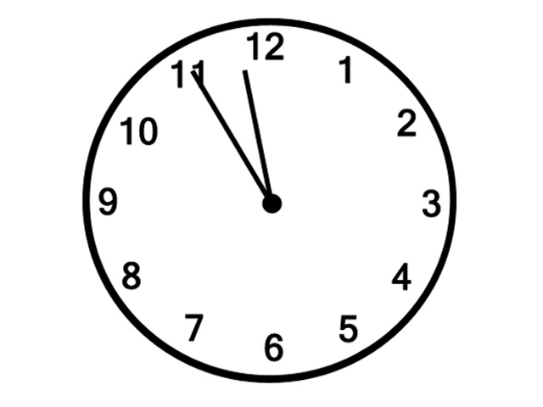
Recommendations
Time is of the essence. Bob, as CEO, has to determine how much time he wants to dedicate to resolving the conflict.
Bob is feeling pressured to deal with the conflict immediately, then resorting to alternative one of ending the relationship, will be the best solution as it will take the least amount of time to pursue.
Notes:
If he truly values Ken's talent and friendship he will allow enough time to utilize supportive confrontation.
If he has some time to create a BATNA, this will be the best opportunity to save the working relationship and friendship Bob has with Ken

Slide 38
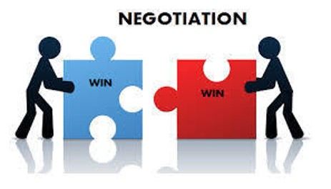
Recommendations
The best solution for the issue is for Bob to progressively confront Ken
Establish a BATNA
Bob’s influence over Ken
Win-Win scenario
Final straw
.
Notes:
By establishing a BATNA while using the tactics of supportive confrontation, he may achieve acceptable middle ground in which all parties, and the company, can truly benefit.
He has always successfully influenced Ken, and using this trust and power will be a major advantage to remedy the situation. Using this method will take time and will reflect how much value Bob has for Ken and for their relationship.
If completed properly, the end result is a Win-Win scenario that can repair all components of this situation.
Letting Ken go will be the final straw if no commitment to an agreement is foreseeable.
After all, there is adequate justification for doing so, and Bob can be confident that he is presented well within the eyes of his employees for putting in the time and effort to intervene.

Slide 39


Recommendations
Whatever the outcome, Bob will need to make some changes within the resolution process to include better communication strategies and conflict management processes for Tidewater.
More conflict will arise
Environment –Conflict resolution
Remove threat, criticism and attack
Notes:
Whatever the outcome, Bob will need to make some changes within the resolution process to include better communication strategies and conflict management processes for Tidewater.
There will be more conflict in the future of which Tidewater will be more prepared for.
Bob may need to demonstrate flexibility and consider creating an environment where confrontation and managing conflict is encouraged.
Doing this will help to remove threat, criticism and attack. In fact, the entire company needs to start building an environment that handles all issues, including conflict in a constructive and respectful manner.
Tidewater needs to be a work environment where employees feel safe and confident and honest about what one is thinking and or feeling, especially in the face of change.

Slide 40


From
Laura
Susan
Tim

